Slide 1
Startups: Incorporation, Funding, Contracts, and Intellectual Property
Professor Barich
Class 10

Slide 2
Reminders
Exam #2 – Second half of today’s class
  First Half - New material not on Exam
  Questions about Exam #2 now and after 1st half
  Review Exam #2 next class

Slide 3
Intellectual Property
What is Intellectual Property (IP)?
  Broad term encompassing many rights that are very different
  May be embodied in a physical object, but the right itself is intangible
  So important that two types of IP (now called © and patent) are in the Constitution itself
    Article 1, Sec 8, Cl. 8
    To promote the Progress of Science and useful Arts, by securing for limited Times to Authors and Inventors the exclusive Right to their respective Writings and Discoveries

Slide 4
Intellectual Property - 2
But what is it?
It’s a right granted to you by the government, the extent and scope of the right is as determined by statute
The scope changes as new laws are passed (IP laws frequently change in scope)
New IP rights can be added at any time (and are)
Compare with legal rights of “privacy” and “to bear arms”
  The constitution/statute (and how it is interpreted) sets the extent of your right

Slide 5
Where did IP Come From?
Before IP
  Important discoveries were kept secret so that you (and your heirs or apprentices) could profit from them
  Advanced medical techniques
    Egyptian brain surgery from 3000 BC
  Color formulations of Roman painters
  Metallurgy, construction, agriculture, etc.
Often the discovery was lost!
  No net societal advancement
  No propagation throughout society

Slide 6
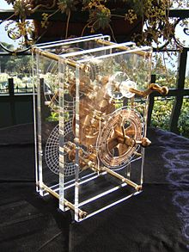
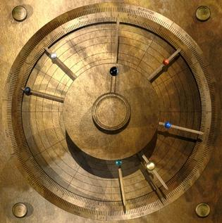
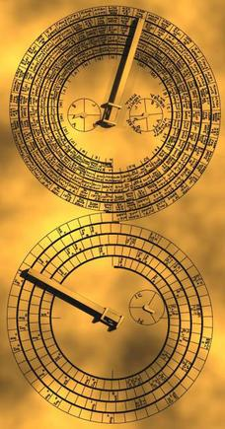
Lost Technology -1
Antikythera mechanism ~200 BCE
  Analog computer - simultaneous calculation of the position of the Sun and Moon, the moon phase, eclipse, and calendar cycles, and locations of some planets
  Not equaled until the 1400s

Slide 7
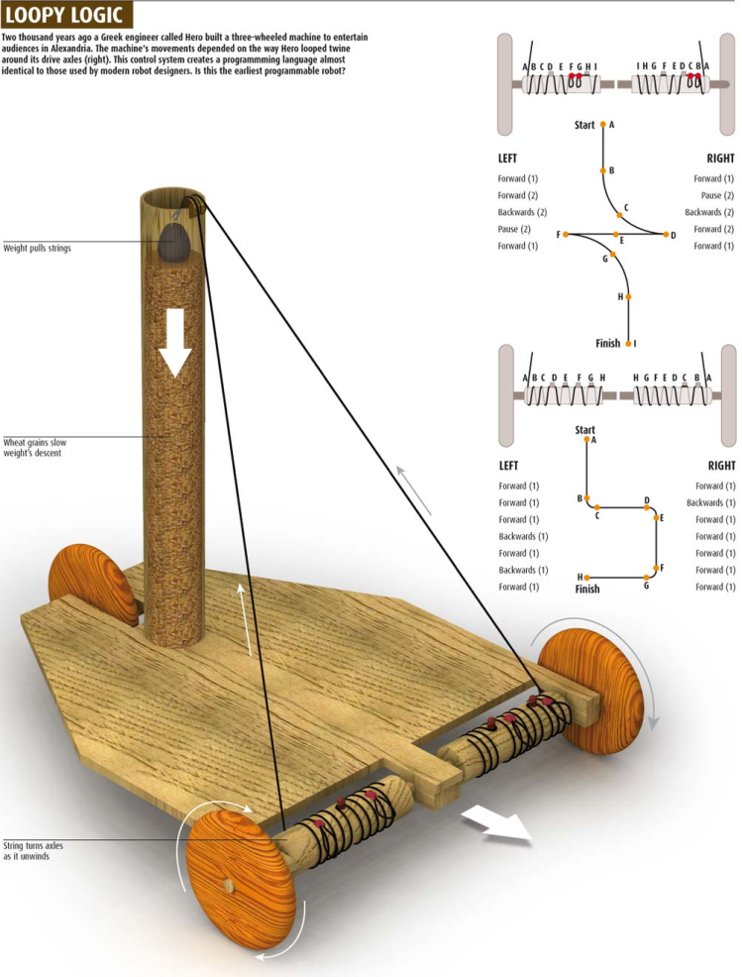
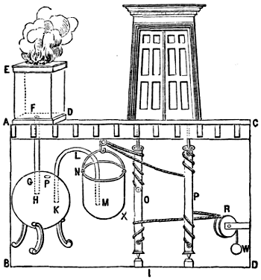
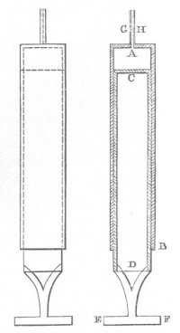
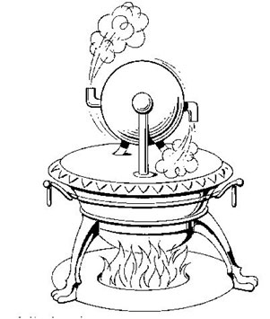
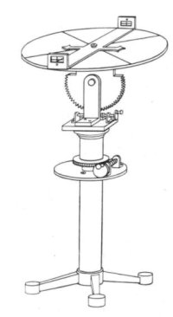
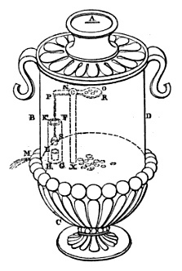
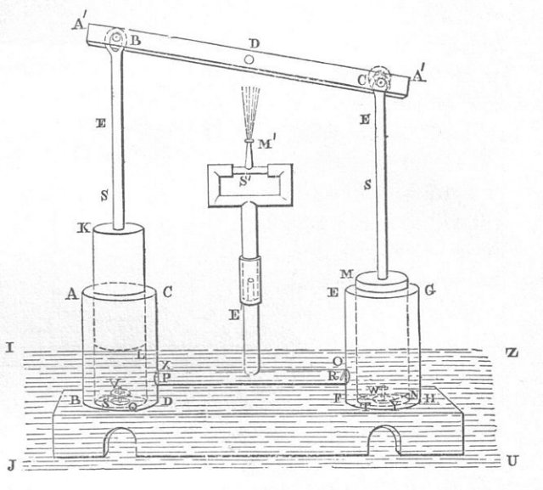
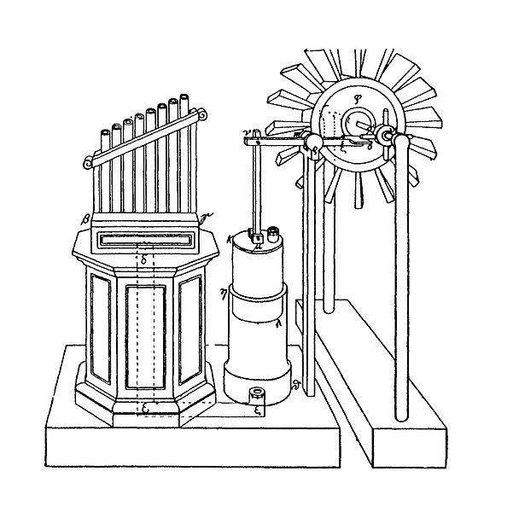
Lost Technology -2
Hero/Heron of Alexandria ~ 100 CE
  Steam engine, wind powered machinery, vending machine, automated doors, programmable cart (rope), water pumps, water-leveled surveying device, syringe

Slide 8
“Ad hoc” Rights
Individual “ad hoc” rights (up to 1600s)
  King can give anyone an exclusive right for any reason
    Called “Letters Patent” meaning (approximately) “public grant of rights”
    Could be the sole right to perform a service or sell a product
  Ex - “Letters Patent” to be exclusive toll taker on a bridge
  If someone invented something great, they might petition the king for “letters patent” granting them the exclusive right to make and sell the invention – often in exchange for a percentage to the king

Slide 9
Need For An Economic Solution
Then: Only secrecy allows the inventor to profit, but a solution is needed to align individual financial incentive with societal gain
Venetian Patent Statute (1474)
  “We have among us men of great genius, apt to invent and discover ingenious devices…if provision were made for the works and devices discovered by such persons, so that others who may see them could not build them and take the inventor’s honor away, more men would then apply their genius, would discover, and would build devices of great utility and benefit to our Commonwealth.”
Give an exclusive right and get more inventions
But! - Exclusive rights for only a limited time – then everyone can use the invention
  Incentive to disclose invention and once everyone knows it, it can’t be lost with inventor’s death, but the inventor still gets to profit and no longer has to worry about theft of idea

Slide 10
IP Rights - 1
“Big 3”
  Patents - (P)
    Functionality
    How something works
  Copyrights - ©
    Expression
    What something looks like, sounds like, etc.
  Trademarks – TM, ®
    Origin of goods in trade
    Who a product comes from
  Can have (P), © and TM/® in same product
Trade Secret – Must be kept secret
  Can’t have both a patent and a trade secret
  Many other IP rights

Slide 11
IP Rights - 2
Patents, Copyrights, Trademarks, and Trade Secrets operate very differently
  Rules for one typically do not apply to the others
  Term “IP” is a very loose grouping
Massive misunderstanding and confusion
  Most businesses do not understand IP rights
  Popular press often gets it wrong
  But! Estimate of value of IP held by SP500 is in excess of $4 trillion

Slide 12
US vs. Many Other Countries
IP - Intellectual Property vs. Industrial Property
  Product of the mind vs. company property
  Historically, US economic development is dominated by entrepreneurs - Europe is dominated by large, state-run industry
  Until recently, only a company could own patents in Europe and many other countries
  Many differences in IP scope due to fundamental principles
    More things are patentable in the US
    Ex – EU = no surgical procedure patents and stricter standards for software patents

Slide 13
Patent Economic Basis
A Patent is not a reward or a prize
  The IP system is not made for the benefit of the inventors – it is made for the benefit of society
  Want to incentivize development of new inventions for everyone’s benefit
  It’s a savvy deal – government can get private industry to pay for R&D instead of having to pay for it with tax dollars
    Ex – It costs $1 Billion+ for new drug
    R&D yearly spend in trillions - $0 to taxpayer, ~80% of total
      Government research grants ~20%
  Limited time of exclusivity, then everyone can use it for free – don’t want to pay a premium? Just wait a few years.
  Exclusivity gives inventors confidence that their investment will pay off – otherwise no investment!

Slide 14
TM and © Economic Basis
Trademark
  We want consumers to know who makes the goods they are buying so that the manufacturer will make high-quality goods and stand behind them
  Want to be sure consumers are not deceived into purchasing inferior goods once manufacturers have made that investment
    No “passing off”, “counterfeiting”, “knock-offs”
Copyright
  Everyone likes a new story or song! We want more.
  For artistic works requiring large investment (movies), exclusive rights incentivize production

Slide 15
Trade Secret Economic Basis
Trade secrets derive economic value from not being known
Why provide a protectable right for something a business wants to keep secret?
  Fair competitions between companies
    EX – wrongfully obtaining the marketing plan of a competitor provides you with an unfair advantage
  Encourage investment in innovation
    Not every innovation can be patented, but we want companies to innovate on their own rather than steal the innovations of others

Slide 16
Reality of IP Rights - 1
It’s really all about the money
  Massive lobbying because a single statutory change can result in huge profits (company vs. company or individual)
  Example: Some rights are getting longer
    Copyrights from 14 (originally) to life+70/95/120 years
    Patents = 7->14->21->17->20 years in length
    TMs have always been for as long as used
  Rights constrained when lobbied for and against
    Example: Corporate innovators want patent rights expanded
      Aggregators or those with market dominance want patent rights reduced
      Balanced = patent term stays about the same
    Compare: All companies want longer copyright term
      Regular people have no lobbyist
      Legislators are not asserting interests of regular people
      Unbalanced = Copyright term hugely increases

Slide 17
Reality of IP Rights - 2
Some rights are changing in scope in recent decades
  Patents somewhat diminished
    Fewer inventions patentable, more likely to be found obvious, tougher to get injunction
  Copyright has increased significantly
    “Make available for copying” is now infringement, even if no copy made
    Criminal prosecution for © infringement even when there is no monetary profit or commercial benefit from the infringement. Up to 5 years and $250,000. FBI now investigates.
    Statutory damages raised (up to $150K for a single work)
  Trademark has increased somewhat
    Dilution (multiple class) protection for famous marks

Slide 18
Reality of IP Rights - 3
Lots of BS-ing (or “exploitable uncertainty”)
  If I claim I have a right and you don’t challenge it, then I effectively have that right – whether or not I am entitled to it under the law
    People claiming a device infringes their patent
    Claiming copyright infringement based on similarity
    Claiming common-law trademark rights without establishing consumer association
Litigation costs can be outcome determinative
  If you can’t afford to fight, then you have to give up
  Can be tough for individuals or small companies to enforce against large companies
  Large companies can (and will) out spend you
  “Might” can make “rights”

Slide 19
IP Not Like Contracts
Different basis than contract law
  Contracts
    Emerges from basic principles of fairness
    Reasonableness
    Slow to change
    Highly jury dependent
    Damages based on actual damages from breach
  IP
    Economic tool to drive societal development
    Completely a creation of the statute
    Does not have to be reasonable
    Can have statutory damages
    Much more change than contract law

Slide 20
IP Law Changes Often
IP rights will continue to be around, but they change all the time
  Federal statute changes
    Example – Sept 2011 America Invents Act (AIA) – biggest patent law change since Patent Act in 1952
  Agency rule changes
  Court cases interpreting the law
We will just be scratching the surface
  This course will not make you an expert
  There are many exceptions to most rules
  Consult a lawyer if you have an issue
  Goal: Well-informed, IP-savvy entrepreneur!

Slide 21
Questions?
Bring Coursepack – or print copies of patents, applications, and design patents from joebarich.com for next time

