Slide 1


Patent Law and the Entrepreneur
Notre Dame
Joe Barich

Slide 2
Agenda
Who is Joe Barich?
IP Overview
Patents
  Utility Patents
  Provisional Patent Applications
  Entrepreneur Patent Advice
Summary
Note: This presentation represents educational and general opinion information. It is not advice with regard to any specific factual situation and does not create an Attorney/Client relationship.

Slide 3
Who is Joe Barich?
U. of Illinois BS, MS Electrical Engineering
Boston College JD
26 years as an IP attorney
  15 at large firm IP specialty firm
  Founded Barich IP Law Group in 2013
20 years as a Professor
  Adjunct Professor, U of I College of Law
    Patent Prosecution, IP Clinic, Intro to IP
  Lecturer, U of I College of Engineering
    Engineering Law
    Startups: Incorporation, Funding, Contracts, and IP
  Senior Lecturer, U. of Wisconsin, Masters of Engineering Management Program
    Engineering Law

Slide 4
Who is Joe Barich?
2019-2024 Illinois SuperLawyer and 4 time Illinois Rising Star on the Super Lawyers list
Patent Buddy® List of Top Patent Prosecutors (top 2%) in the areas of "Computer, Electrical, Software, and Business Methods“
Prosecuted 1800+ patents, 600+ trademarks, and numerous copyrights in the US and internationally
Totally humble and never sarcastic! ☺

Slide 5
Agenda
Who is Joe Barich?
IP Rights In Context
Patents
  Utility Patents
  Provisional Patent Applications
  Entrepreneur Patent Advice
Summary

Slide 6
IP In General
What is Intellectual Property (IP)?
  A right granted by the government, the extent and scope of which are exactly determined by statute
    New IP rights can be added by statute at any time
    IP laws frequently change in scope as new laws are passed and new cases heard
  Broad term encompassing many rights that are very different in creation, grant, and enforcement
    Rules that apply for one type of IP typically are different for another type so must treat each type of IP separately
  May be embodied in a physical object, but the right itself is intangible
  Economic tools, not moral rights

Slide 7
Main Types of IP
Patents - (P)
  Functionality
  How something works
Design Patents
  Ornamental Appearance of industrial article
Copyrights - ©
  Expression
  What something looks like, sounds like, etc.
Trademarks – TM, ®
  Origin of goods in trade
  Who a product comes from
Trade Secret
  Information that is valuable and secret
Can have (P), ©, and TM/® in same product
Many other IP rights

Slide 8
Where did Patents Come From?
Before Patents
  Important discoveries were kept secret because that was the only way that you (and your heirs or apprentices) could profit from them
Often the discovery was lost!
  Inventors died a lot
  No net societal advancement
  No propagation throughout society
All manner of inventions were lost
  Advanced medical techniques
    Egyptian brain surgery from 3,000 BC
  Roman techniques for architecture, road-building, metallurgy, agriculture, etc.

Slide 9
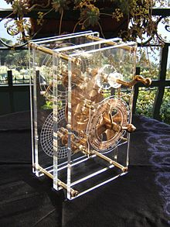
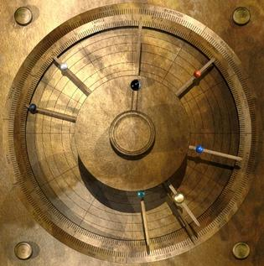
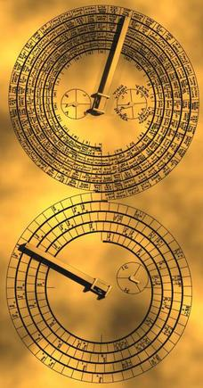
Lost Technology -1
Antikythera mechanism ~200 BC
  Analog computer - simultaneous calculation of the position of the Sun and Moon, the moon phase, eclipse, and calendar cycles, and locations of some planets
  Not equaled until the 1400s

Slide 10
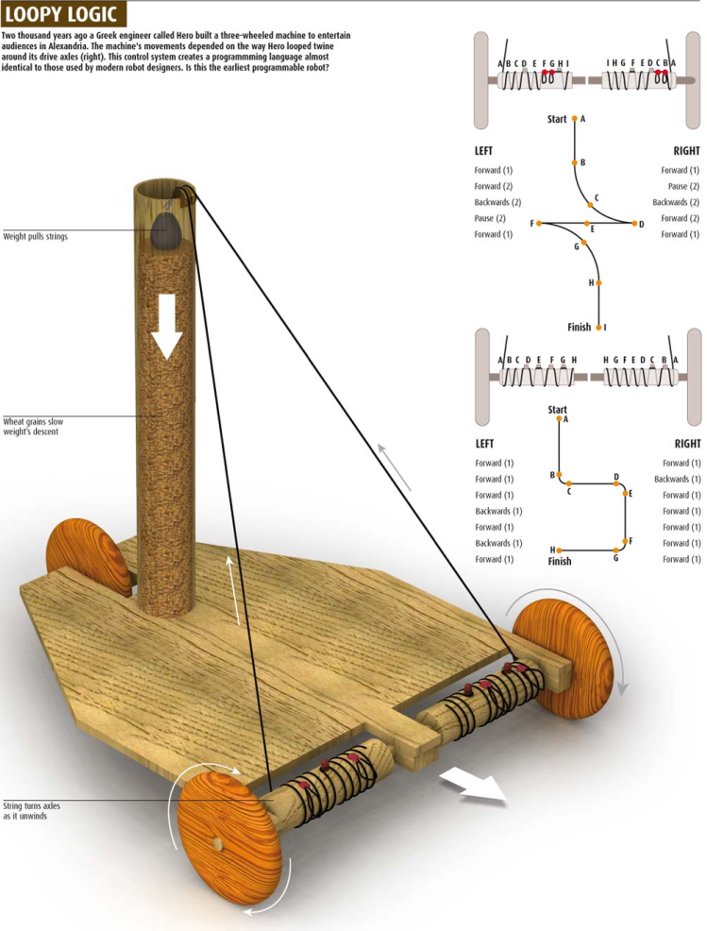
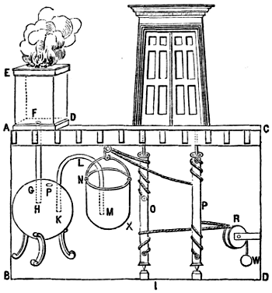
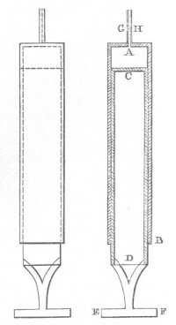
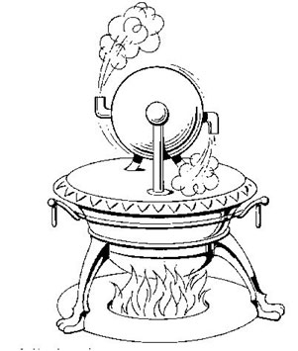
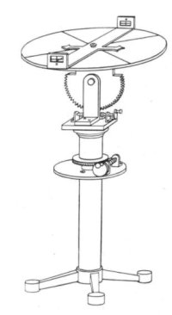
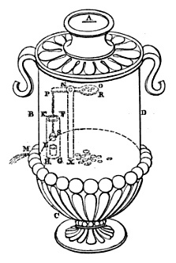
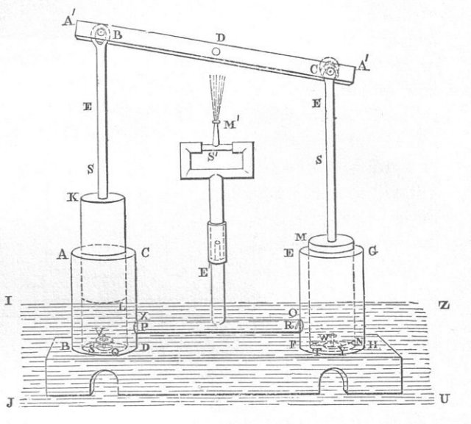
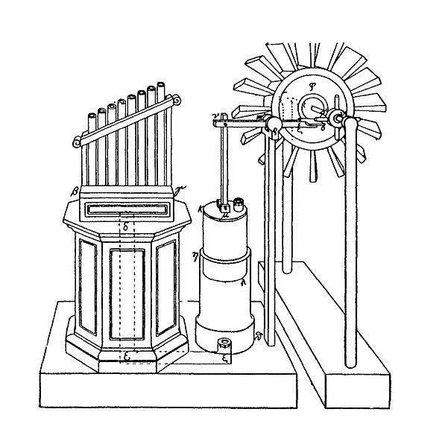
Lost Technology -2
Hero/Heron of Alexandria ~ 100 AD
  Steam engine, wind powered machinery, vending machine, automated doors, programmable cart (rope), water pumps, water-leveled surveying device, syringe

Slide 11
Need For An Economic Solution
Then: Only secrecy allows the inventor to profit, but a solution is needed to align individual financial incentive with societal gain
Venetian Patent Statute (1474)
  “We have among us men of great genius, apt to invent and discover ingenious devices…if provision were made for the works and devices discovered by such persons, so that others who may see them could not build them and take the inventor’s honor away, more men would then apply their genius, would discover, and would build devices of great utility and benefit to our Commonwealth.”
Give an exclusive right and get more inventions
But! - Exclusive rights for only a limited time – then everyone can use the invention
  Incentive to disclose invention and once everyone knows it, it can’t be lost with inventor’s death, but the inventor still gets to profit and no longer has to worry about theft of idea

Slide 12
Patent Economic Basis
A Patent is not a reward or a prize
  The IP system is not made for the benefit of the inventors – it is made for the benefit of society
  Want to incentivize development of new inventions for everyone’s benefit
  It’s a savvy deal – government can get private industry to pay for R&D instead of having to pay for it with tax dollars
    Ex – It costs $1 Billion+ for new drug
    R&D yearly spend in trillions - $0 to taxpayer
    (Although some govt. research grants in some cases)
    Voluntary investment vs. involuntary taxation
Limited time of exclusivity, then everyone can use it for free – don’t want to pay a premium? Just wait a few years
  Exclusivity gives inventors confidence that their investment will pay off – otherwise no investment!

Slide 13
TM and © Economic Basis
Trademark
  We want consumers to know who makes the goods they are buying so that the manufacturer will make high-quality goods and stand behind them
  Want to be sure consumers are not deceived into purchasing inferior goods once manufacturers have made that investment
    No “passing off”, “counterfeiting”, “knock-offs”
Copyright
  Everyone likes a new story or song! We want more.
  For artistic works requiring large investment (movies), exclusive rights incentivize production
    No one would invest $100M otherwise

Slide 14
Reality of IP Rights - 1
It’s really all about the money
  Massive lobbying because a single statutory change can result in huge profits (company vs. company or individual)
  Example: Some rights are getting longer
    Copyrights from 14 (originally) to life+70/95/120 years
    Patents = 7->14->21->17->20 years in length
    TMs have always been for as long as used
  Rights constrained when lobbied for and against
    Corporate innovators want patent rights expanded
    Aggregators or those with market dominance want patent rights reduced
    Compare: All companies want longer copyright term
    Regular people have no lobbyist
  Patents are the only protection that small businesses have
    Can be underpriced and driven out of business by large companies with market power
    Less predation = better economy

Slide 15
Reality of IP Rights - 2
Some rights are changing in scope in recent decades
  Patents somewhat diminished
    Fewer inventions patentable, more likely to be found obvious, tougher to get injunction
  Copyright has increased significantly
    “Make available for copying” is now infringement, even if no copy made
    Criminal prosecution for © infringement even when there is no monetary profit or commercial benefit from the infringement. Up to 5 years and $250,000. FBI now investigates.
    Statutory damages raised
  Trademark has increased somewhat
    Dilution protection for famous marks

Slide 16
Reality of IP Rights - 3
Lots of BS-ing (or exploitable uncertainty)
  If I claim I have a right and you don’t challenge it, then I effectively have that right – whether or not I am entitled to it under the law
    Wrongly claiming a device infringes a patent
    Claiming copyright infringement based on similarity
    Claiming common-law trademark rights without establishing consumer association
Litigation costs can be outcome determinative
  If you can’t afford to fight, then you have to give up
  Can be tough for individuals or small companies to enforce against large companies
  Large companies can (and will) out spend you
  “Might” can make “rights”

Slide 17
Agenda
Who is Joe Barich?
IP Rights In Context
Patents
  Utility Patents
  Provisional Patent Applications
  Entrepreneur Patent Advice
Summary

Slide 18
What is a Patent?
Legal right to exclude others from practicing your invention
  Not a right for you to actually make or sell it
  Patents don’t actually “Protect an invention”, but they sort of protect a market share by granting exclusivity for a feature
Having a patent does not guarantee that you are not infringing the patents of others
  Patent and Trademark Office (PTO) examines your patent application for novelty, not infringement
  Car/Radio Example
U.S. patents are now (post 2013) awarded to the first to file, not the first to invent
  Consequence: Even if you invent first, if you don’t file first then you lose your rights

Slide 19
Novelty (PTO) ≠ Infringement (Sales)
Inventor #1
Inventor #2
CAR
+
RADIO
CAR
Patent #1
- Novelty-
Patent #2
Can’t sell a car with a radio in it without infringing Patent #2
Can’t sell a car with a radio in it without infringing Patent #1 (can’t sell ANY car without infringing Patent #1)
- Infringement-

Slide 20
What is a Patent Application?
Formal document filed with the PTO in an attempt to obtain a patent for an invention
  Best to seek legal assistance
Includes
  Description/specification (your invention)
  Claims (the legal protection that you want for your invention)
  Note: Specification can NOT be corrected once filed
“A written description sufficient to enable one of ordinary skill in the art to practice the invention without undue experimentation and showing the inventor’s best mode”
PTO rejects your claims and you (or more likely your attorney) negotiate, argue, and amend

Slide 21
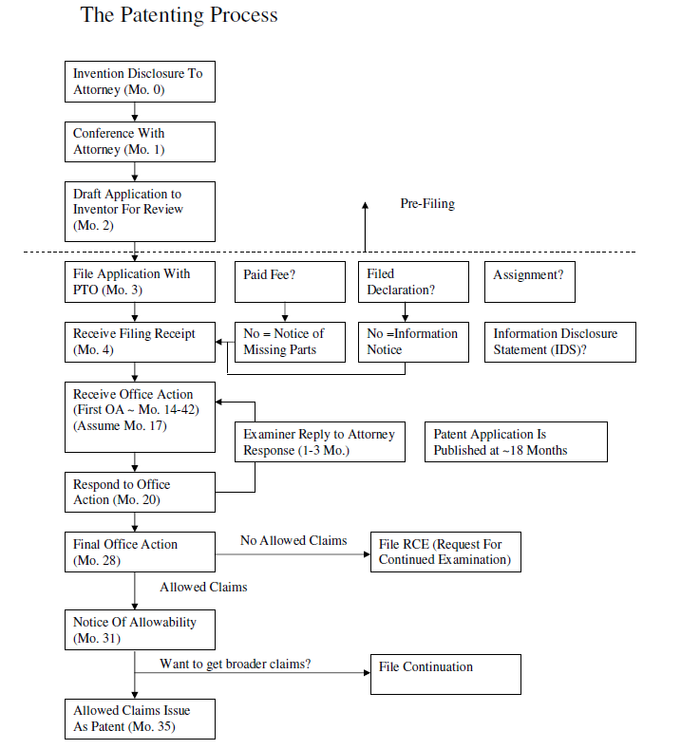
Provisional Application
(up to 12 months before regular app)
Patenting
Process

Slide 22
Patent Statutory Requirements
Claims must satisfy 35 U.S.C. sections -
  §101 – Claim statutory subject matter
    Process, machine, manufacture, or composition of matter
    No abstract principles, ideas, formulas, algorithms
    “Can I get a patent on my idea?” No. Invention? Yes.
    Ex - Concept of warp drive vs. schematic of how to build it
  §102 – Be Novel
    No one single piece of prior art teaches all of the limitations in your claim
  §103 – Be Non-obvious
    Seven PTO rationales based on prior art
    “Obvious” has legal meaning, not ordinary
  §112 – Application must have Written Description, Enablement, and Best Mode

Slide 23
What is Prior Art?
In general, anything out there before your invention or anyone ahead of you in line at the PTO
  §102(a)(1) – Anything published, in use, or available to the public anywhere in the world before your filing
    Exception – your own disclosure if < 1 year before filing
    Yes, your own disclosure can be prior art to you if you delay more than 1 year
  §102(a)(2) – Any patent application filed before your filing that is later published
  Prior Art as defined in §102 is applied/used in both §102 and §103

Slide 24
Warning! - BAR DATES!
U.S. has a One Year Grace Period from date of first disclosure or commercialization
  File your patent application or lose rights forever
Outside U.S. = Often No Grace Period = disclose/ commercialize before filing and you blew it forever
Preserve foreign rights by filing an application in the U.S. before disclosure/commercialization and then later filing foreign app claiming priority to U.S. app
  Must be done within 1 Year
  Can be a provisional application
Disclosures in confidence (to attorney, under agreement of confidentiality), without commercialization, are typically OK

Slide 25
Novelty vs. Infringement
PTO only examines for novelty
  If claim recites ABCDE and prior art only shows ABCD, then claim is NOVEL because there is one limitation not taught by the prior art – it is NEW!
  However, there may be an earlier patent with claims to ABCD so if the ABCDE product is made, the product infringes the earlier patent
Conversely, all of the limitations of the claim must be found in the alleged infringing product for infringement to occur
  If claim is ABCDE, products ABC, ABCE, and ABCDG do not infringe
  However, ABCDEF would infringe because it includes all of ABCDE plus something else

Slide 26
Patent Claims - 1
Patents typically include many claims
  Try to broaden coverage of your invention by claiming it in multiple ways
Different claim types (System, Method, etc.)
  Varying strengths and weaknesses
  Example - Must be performed entirely within US?
    Method = yes, System = no
  Method claims are generally thought to be broader
  System claims may be harder to invalidate
Only a single claim of a patent needs to be infringed for full damages
  Damages do not increase if multiple claims are infringed

Slide 27
Patent Claims - 2
In general, the shorter the claim (fewer elements), the broader the claim
  Broader claim may be more valuable because it locks away a larger scope
  May be more vulnerable to invalidity attack
File Continuations - get more patents!
  Most patent applications are 1:N rather than 1:1
  Often have several issued continuations with later claims having broader scope
  Can keep a continuation pending to introduce new claims directed to competitor’s embodiment –BUT! all claim elements must be supported by the original specification

Slide 28
Litigating a Patent
Patents can be invalidated at trial
  The opposing counsel typically finds new prior art not considered by the Examiner
    The Examiner only spends $1820 worth of time to find prior art, but the company being sued may spend millions
  The new art may be used to “second guess” the PTO and invalidate patent – Ex. –it may lack novelty or be obvious
  “Clear and convincing” standard – not “beyond a reasonable doubt” or “more likely than not” gives some deference to PTO
  Willful infringement can treble damages
    Defeat with Opinion of Counsel
If you are sued, fight back using both invalidity and non-infringement arguments
  You win by establishing either:
    (a) their patent is invalid, or
    (b) your product does not infringe their claims

Slide 29
Patent Term
Filing =“Patent Pending”
  Can’t sue yet – Can only sue with issued patent
  Filing a patent application with the PTO is said to be “prosecuting a patent” and the process is often called “patent prosecution.”
  No rights to enforce patent until issuance
Term of patent is 20 years from its effective filing date (date of first filing in the chain, AKA date of priority)
  But! takes 3-5 years to issue as a patent right thus providing an enforceable term of approximately 15-17 years
  Also, often have chains of continuations with claims of different scopes or directed to different subcomponents of the invention
    All expire on the same date, 20 years from the first one’s filing date (priority date)

Slide 30
Provisional Patent Application
Quick and less formal filing with PTO
  Gives you a priority date (for subject matter disclosed) – essentially a placeholder
  Good for avoiding a bar date
  Still MUST be an enabling written description
  Cheaper ($2-4K vs. $8-12K)
  Only lasts for one year – must then file utility application or your provisional is abandoned
  No “provisional patent”! Provisional Application!
Often filed as “option” by inventor, then shop around and file utility if funded
  One provisional can become many utility patent applications and vice versa

Slide 31
Entrepreneur Patent Advice - 1
There are a lot of “moving parts” here and mistakes are often not recoverable.
  Use patent-specialty counsel, not just General Counsel
  Communicate! Ask for advice!
You might not know if something is patentable
  Inventors don’t know when they have invented something patentable – or even the basics of patent law
  Get it in front of your patent counsel
Be aware of bar dates
  Disclosure OR Commercialization – NDA does not help with commercialization
  1 year in U.S. – No grace period in some countries outside US
If something is unclear, bring it up right away – many patent aspects are date-dependent

Slide 32
Entrepreneur Patent Advice - 2
File provisional applications
  Patent goes to the first to file. You must have the earliest date.
  Can file multiple provisionals as work progresses.
Document Ownership
  Inventors should explicitly assign their rights to the company. Do not rely on the employee handbook.
  Watch out for unnamed co-inventor
  Make sure assignments are filed in PTO registry
Consider rights outside U.S.
  Ask your patent counsel – Direct country filing, PCT
Maximize your rights with continuations
  Can get better claims and be more flexible in enforcement
Periodically reevaluate your portfolio
  Keep conscious of costs and evaluate for financial impact. You might not need multiple continuations of a minor-value product

Slide 33
Entrepreneur Patent Advice - 3
Perform patent searching (freedom to operate) analysis before releasing new product or service
Be cautious if someone claims you infringe
  People are often overly-aggressive
  Get a patent lawyer to analyze claims
Don’t make adverse internal records – and make sure your team doesn’t either
  Everything is discoverable – even “personal” communications
  Text message saying “I love how we are copying X’s product” will be Exhibit #1 in the patent infringement suit
  This goes for all forms of IP

Slide 34
Agenda
Who is Joe Barich?
IP Rights In Context
Patents
  Utility Patents
  Provisional Patent Applications
  Entrepreneur Patent Advice
Summary

Slide 35
Summary Chart
IP Right | Directed Towards | How Obtained? | Term | Standard for infringement
Patent | Invention | Granted by PTO | 20 years from effective filing date | Compare Claims to alleged product
Design Patent | Ornamental Appearance | Granted by PTO | 15 years from issuance | Ordinary observer
© | Artistic Expression | Arises at creation, register for statutory damages | Life of author +70 or up to 120 years | Copying, substantial similarity, derivative work
TM | Origin of Goods | Consumer association | As long as used | Consumer confusion
® | Origin of Goods | Granted by PTO | As long as used | Consumer confusion
Trade Secret | Secret Info | Keep valuable info secret | As long as valuable and secret | Actual theft

Slide 36
Questions?
Thank You!
Joe Barich
Academic Website: JoeBarich.com
Professional Website: BarichIP.com
Barich IP Law Group
312-620-2471
joebarich@barichip.com
www.barichip.com

